Slide 1
Unit 4 Program Security

Slide 2
Topics to be covered
Secure programs
Non malicious Program
Errors
Viruses and other malicious code
Types of viruses
Attack mechanism of viruses
Targeted Malicious Code
Controls Against Program Threats.

Slide 3
Program Security
Its our first step on how to apply security to computing
Protecting programs is the heart of computer security
All kinds of programs, from apps via OS, DBMS, networks
Issues:
How to keep programs free from flaws
How to protect computing resources from programs with flaws

Slide 4
What is Program Security?
Depends on whom you ask
user
programmer
manager - conformance to all specifications
Developmental criteria for program security include:
Correctness of security & other requirements
Correctness of implementation
Correctness of testing

Slide 5
Fault tolerance terminology
Error - may lead to a fault
Fault - cause for deviation from intended function
Failure - system malfunction caused by fault
Faults - seen by ”insiders” (e.g., programmers)
Failures - seen by “outsiders” (e.g., independent testers, users)

Slide 6
Fault tolerance terminology
Error/fault/failure example:
Programmer’s indexing error, leads to buffer overflow fault
Buffer overflow fault causes system crash (a failure)
Two categories of faults w.r.t. duration
Permanent faults
Transient faults – can be much more difficult to diagnose

Slide 7
Secure Programs
What is a secure program?
Everyone has their own requirement of “being secure”
Part of assessing software quality
Does it meet security requirements in specification?
In general, we often look at quantity and types of faults for evidence of security.

Slide 8
Fixing Faults
Finding lots of faults in software early.
NOT GOOD.
Early approaches were “Dig” and then “Patch”
NOT GOOD.
Repairing with a patch is a narrow focus area.
Patches can cause other problems.
Non obvious side effects
Fix one place – fails another
Performance or function suffers

Slide 9
Flaws
Comparing program requirements with behavior to identify any unexpected behavior is called as program security flaw
Flaw is either a fault or failure
Vulnerability is a class of flaws (e.g. buffer overflow)
Need to determine how to prevent harm caused by possible flaws
Hindrances for eliminating program security flaws
How do we test for what a program shouldn’t do?
Programming and software engineering techniques evolve more rapidly than computer security techniques

Slide 10
Types of Flaws
Intentional
Malicious
Nonmalicious
Inadvertent
Validation error (incomplete / inconsistent): permission checks
Domain error: controlled access to data
Serialization and aliasing: program flow order
Inadequate identification and authentication: basis for authorization
Boundary condition violation: failure on first or last case
Other exploitable logic errors

Slide 11
Non-malicious Program Errors
These errors cause program malfunctions but do not lead to more serious security vulnerabilities
We consider three classic error types:
Buffer overflows
Incomplete mediation
Time-to-check to Time-to-Use Errors

Slide 12
Nonmalicious Program Errors
Buffer Overflows
A buffer is a space in which data can be held. A buffer’s capacity is finite.
The programmer must declare the buffer’s max. size so that the compiler can set aside that amount of space.

Slide 13
Nonmalicious Program Errors
Buffer Overflows
char sample[10];
for (i=0; i<=9; i++)
sample[i] = ‘A’;
sample[10]=‘B’
All programs and data are in memory during execution, sharing space with the OS, other code.
There are 4 cases to consider in deciding where ‘B’ goes.

Slide 14
Nonmalicious Program Errors
Buffer may overflow into (and change):
User’s own data space
User’s program area
System data space
System program area

Slide 15
Nonmalicious Program Errors
Buffer Overflows:
User’s Data
Memory
A
A
A
A
A
A
A
A
A
A
B
a) Affects user’s data
User’s Program
code
User’s Data
Memory
A
A
A
A
A
A
A
A
A
A
B
a) Affects user’s code

Slide 16
Nonmalicious Program Errors
Buffer Overflows:
User’s Data
System data
Memory
A
A
A
A
A
A
A
A
A
A
B
a) Affects system data
System Program
code
User’s Data
Memory
A
A
A
A
A
A
A
A
A
A
B
a) Affects system code

Slide 17
Nonmalicious Program Errors
Buffer Overflows Security Implication
Attacker replaces code in the system space and takes control back from the operating system
Attacker uses the stack pointer or return register to execute other codes

Slide 18
Nonmalicious Program Errors
Incomplete Mediation (data checking)
Attackers are exploiting it to cause security problems.
Supplying the wrong type of data being requested.
Supplying the wrong length of data being requested.
Problem
System Fails
Supply of Bad Data
Must be checked by programmer
Client side v/s Server Side
http://www.somesite.com/subpage/data&parm1=(808)555-1212&parm2=2004Jan01
What if parm2 is 1800Jan01 or 2004Feb30…
the user could send incorrect data to the server
Security Implication
Easy to exploit

Slide 19
Nonmalicious Program Errors
Time-of-Check to Time-of-Use Errors
The third programming flaw we investigate involves synchronization.
To improve efficiency, modern processors and operating systems usually change the order in which instructions and procedures are executed.
In particular, instructions that appear to be adjacent may not
actually be executed immediately after each other, either because of intentionally changed order or because of the effects of other processes in concurrent execution.

Slide 20
Nonmalicious Program Errors
Time-of-Check to Time-of-Use Errors
Definition:
Access control is a fundamental part of computer security; we want to make sure that only those who should access an object are allowed that access.
This flaw concerns mediation that is performed with a "bait and switch" in the middle. It is also known as a serialization or
synchronization flaw.

Slide 21
Nonmalicious Program Errors
Bait-and-switch is a form of fraud used in retail sales but also employed in other contexts.
First, customers are "baited" by merchants' advertising products or services at a low price, but when customers visit the store, they discover that the advertised goods are not available, or the customers are pressured by salespeople to consider similar, but higher-priced items ("switching").
Security Implication
to avoid checking one action and performing another – use digital signatures and certificates

Slide 22
Time of Check, Time of Use
ToCToU conditions
Can occur during file I/O
first checking some object and then using it

Slide 23
Nonmalicious Program Errors
Combinations of Nonmalicious Program Flaws
These three vulnerabilities are bad enough when each is considered on its own.
But perhaps the worst aspect of all three flaws is that they can be used together as one step in a multistep attack.

Slide 24
Viruses and Other Malicious Code
When was the last time you saw a bit?
Do you know in what form a document file is stored?
Can you find where a document resides on a disk?
Can you tell if a game program does anything in addition to its expected interaction with you?
Which files are modified by a word processor when you create a document?
since users usually do not see computer data directly, malicious people can make programs serve as vehicles to access and change data and other programs.
Notes:
Abnormal activity

Slide 25
Malicious Code
Malicious code is the general name for unanticipated or undesired effects in programs or program parts caused by an agent intent on damage.
The agent is the writer of the program or a person who causes its distribution.

Slide 26
Kinds of Malicious Code
Virus – code that attaches to another program and copies itself to other programs
Transient virus – life depends on life of its host
Resident virus – locates inside memory
Trojan Horse – malicious effect is hidden from user (Ex: login script)
Logic viruses – triggered by an event and goes off when specific condition occur
Time viruses – triggered by a time or date

Slide 27
Kinds of Malicious Code
Trapdoor (backdoor) – feature that allows access to program other than through normal channels
Worm – program that spreads copies of itself through a network, can be stand alone program
Rabbit – virus/worm that self-replicates without bound

Slide 28
Kinds of Malicious Code
Code type | Characteristics
Virus | Attaches itself to program and propagate copies of itself to other programs
Trojan horse | Contains unexpected additional functionality
Logic bomb | Triggers action when condition occurs
Time bomb | Triggers action when specified time occurs
Trapdoor(Backdoor ) | Allows unauthorized access to functionality
Worm | Propagates copies of itself through network
Rabbit | Replicates itself without limit to exhaust resources

Slide 29
Study Assignment Based on the kinds of MALICIOUS CODE identify two examples of each type and explain in details.

Slide 30
How do Viruses Attach
A virus is attached to a “program”
The virus is activated by executing the program
Most common viruses today are attached to e-mail; when the attachment is opened, virus is active
Three ways:
Appended
Surrounds programs
Integrated viruses and replacements

Slide 31
Appended Viruses
A program virus attaches itself to a program; then, whenever the program is run, the virus is activated. This kind of attachment is usually easy to program.
This kind of attachment is simple and usually effective.
The virus writer does not need to know anything about the program to which the virus will attach, and often the attached program simply serves as a carrier for the virus.

Slide 32
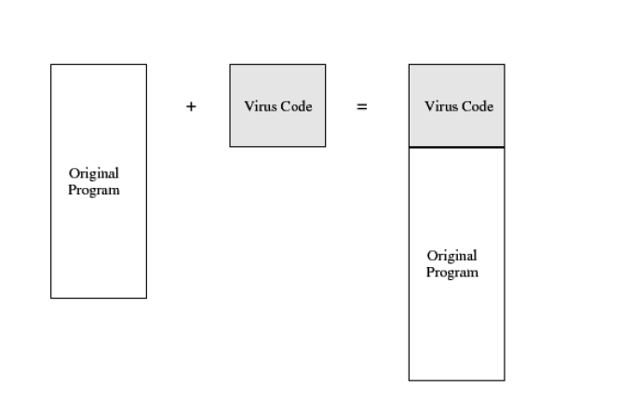
Appended virus example

Slide 33
Viruses That Surround a Program
An alternative to the attachment is a virus that runs the original program but has control before and after its execution.

Slide 34
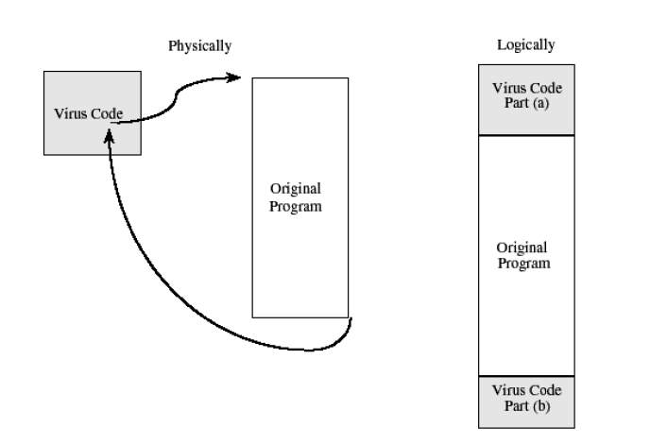

Slide 35
Integrated Viruses and Replacements
A third situation occurs when the virus replaces some of its target, integrating itself into the original code of the target.
The virus writer has to know the exact structure of the original program to know where to insert which pieces of the virus.
Finally, the virus can replace the entire target, either mimicking the effect of the target or ignoring the expected effect of the target and performing only the virus effect

Slide 36
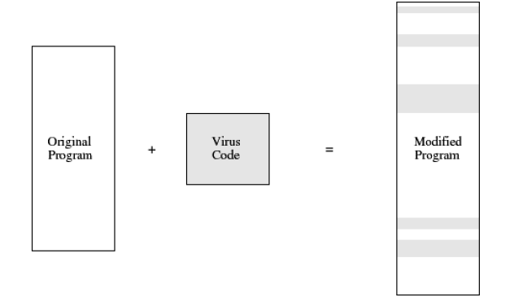

Slide 37
How viruses gain control
The virus V has to be invoked instead of the target (T).
Virus (V) modify/overwrite the program (T) in storage.
Virus can change file pointer in file table for itself to be located instead of T.

Slide 38
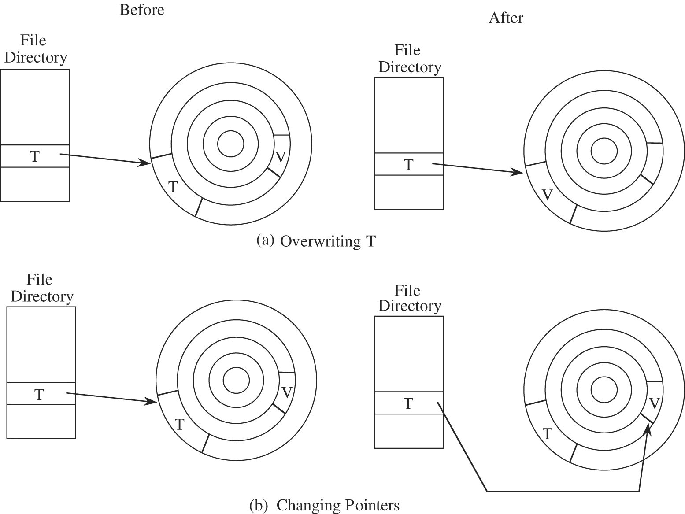
How viruses gain control

Slide 39
Home for viruses
It is hard to detect.
It is not easily destroyed or deactivated.
It spreads infection widely.
It can reinfect its home program or other programs.
It is easy to create.
It is machine independent and operating system independent

Slide 40
Types of viruses
One time execution
Boot sector viruses
Memory resident viruses
Document viruses

Slide 41
One-Time Execution
The majority of viruses today execute only once, spreading their infection and causing their effect in that one execution.
A virus often arrives as an e-mail attachment of a document virus.
It is executed just by being opened.

Slide 42
Boot Sector Viruses
A special case of virus attachment
When a computer is started, control begins with firmware that determines which hardware components are present, tests them, and transfers control to an operating system.
The operating system is software stored on disk. Code copies the operating system from disk to memory and transfers control to it; this copying is called the bootstrap (often boot) load.

Slide 43
Boot Sector Viruses
To allow for change, expansion, and uncertainty, hardware designers reserve a large amount of space for the bootstrap load.
The boot sector on a PC is slightly less than 512 bytes, but since the loader will be larger than that, the hardware designers support "chaining," in which each block of the bootstrap is chained to (contains the disk location of) the next block.
The virus writer simply breaks the chain at any point, inserts a pointer to the virus code and reconnects the chain after the virus has been inserted.

Slide 44
Memory-Resident Viruses
Some parts of the operating system and most user programs execute, terminate, and disappear, with their space in memory being available for anything executed later.
For very frequently used parts of the operating system and for a few specialized user programs, it would take too long to reload the program each time it is needed.
Such code remains in memory and is called "resident" code.
Virus writers like to attach viruses to resident code because the resident code is activated many times while the machine is running. Each time the resident code runs, the virus does too.

Slide 45
Document Viruses
Currently, the most popular virus type is what we call the document virus, which is implemented within a formatted document, such as a written document, a database, a slide presentation, or a spreadsheet.
These documents are highly structured files that contain both data (words or numbers) and commands (such as formulas, formatting controls, links).

Slide 46
Virus Signatures
A virus cannot be completely invisible.
Code must be stored somewhere, and the code must be in memory to execute.
Moreover, the virus executes in a particular way, using certain methods/characteristics to spread.
Each of these characteristics yields a pattern, called a signature, that can be found by a program that knows to look for it.

Slide 47
Virus Signatures
The virus's signature is important for creating a program, called a virus scanner, that can automatically detect and, in some cases, remove viruses.
The scanner searches memory and long-term storage, monitoring execution and watching for the signatures of viruses.
When the scanner recognizes a known virus's pattern, it can then block the virus, inform the user, and deactivate or remove the virus.
However, a virus scanner is effective only if it has been kept up-to-date with the latest information on current viruses

Slide 48
Storage Patterns
Most viruses attach to programs that are stored on media such as disks.
The attached virus piece is invariant, so that the start of the virus code becomes a detectable signature.
The attached piece is always located at the same position relative to its attached file.

Slide 49
A virus may attach itself to a file, in which case the file's size grows.
Or the virus may obliterate/destroyed all or part of the underlying program, in which case the program's size does not change but the program's functioning will be impaired. The virus writer has to choose one of these detectable effects.
The virus scanner can use a code or checksum to detect changes to a file. It can also look for suspicious patterns, such as a JUMP instruction as the first instruction of a system program

Slide 50
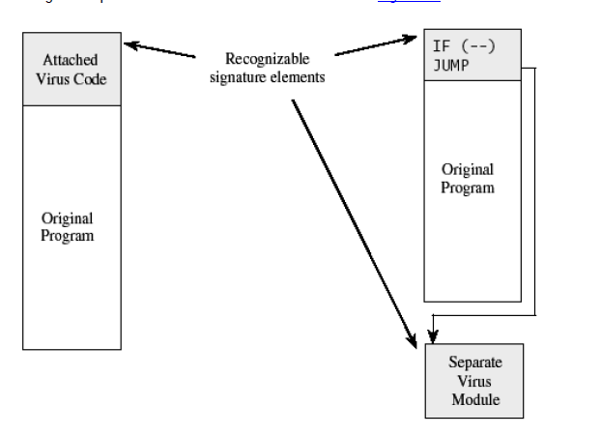

Slide 51
Execution Patterns
A virus writer may want a virus to do several things at the same time, namely, spread infection, avoid detection, and cause harm.
Unfortunately, many of these behaviours are perfectly normal and might otherwise go undetected. For instance, one goal is modifying the file directory; many normal programs create files, delete files, and write to storage media. Thus, there are no key signals that point to the presence of a virus.

Slide 52
Virus effect | How it is caused
Attach to executable program | Modify file directory Write to executable program file
Attach to data or control file | Modify directory, rewrite data, append to data, append data to self
Remain in memory | Intercept/ interrupt by modifying interrupt handler address table. Load self in nontransient memory area
Infect disks | Intercept interrupt Intercept OS call (eg., to format disk) Modify system file Modify ordinary executable program
Conceal self | Intercept system calls that would reveal self and falsify result
Spread infection | Infect boot sector, infect systems program, Infect ordinary program Infect data ordinary program reads to control its execution
Prevent deactivation | Activate before deactivating program and block deactivation Store copy to reinfect after deactivation

Slide 53
Transmission Patterns
A virus is effective only if it has some means of transmission from one location to another. As we have already seen, viruses can travel during the boot process, by attaching to an executable file or travelling within data files.
The travel itself occurs during execution of an already infected program. Since a virus can execute any instructions a program can, virus travel is not confined to any single medium or execution pattern.

Slide 54
Polymorphic Viruses
A virus that can change its appearance is called a polymorphic virus. (Poly means "many" and morph means "form".) A two-form polymorphic virus can be handled easily as two independent viruses.
Therefore, the virus writer intent on preventing detection of the virus will want either a large or an unlimited number of forms so that the number of possible forms is too large for a virus scanner to search for.

Slide 55
Prevention of Virus Infections
Use only commercial software acquired from reliable, well-established vendors
Test all new software on an isolated computer
Open attachments only when you know them to be safe
Make a recoverable system image and store it safely
Make and retain backup copies of executable system files.
Use virus detectors daily and update them regularly

Slide 56
Truths and Misconceptions about viruses
Viruses can infect only Microsoft Windows systems – False
Viruses can modify “hidden” or “read-only” files – True
Viruses can appear only in data files, or only in Word documents, or only in programs – False
Viruses spread only on disks or only in e-mail – False
Viruses cannot infect hardware – True
WINE

Slide 57
EXAMPLES
Brain Virus - Brain (computer virus)
Brain is the industry standard name for a computer virus that was released in its first form in 19 January 1986, and is considered to be the first computer virus for the IBM Personal Computer (IBM PC) and compatibles. Designed by Pakistan
2. Internet Worm - The Morris worm or Internet worm of November 2, 1988, was one of the oldest computer worms distributed via the Internet, and the first to gain significant mainstream media attention.

Slide 58
EXAMPLES
Code RED Worm - Code Red was a computer worm observed on the Internet on July 15, 2001. It attacked computers running Microsoft's IIS web server. Type – Server jamming worm.
SQL-Server Slammer - SQL Slammer is a 2003 computer worm that caused a denial of service on some Internet hosts and dramatically slowed general Internet traffic.
Web Bugs (spyware) - Web bugs are tiny (usually a single pixel) transparent image files on web pages that are used to monitor user's online habits.

Slide 59
TARGETED MALICIOUS CODE
Another class of malicious code is written for a particular system, for a particular application, and for a particular purpose.
Examples:
Trapdoor – undocumented entry point to a module
Salami Attack (Ex. Interest computation). An attack on a computer network which involves the intruder siphoning off small amounts of money from a file and placifile that holds their bank account detailsng them in another file that he or she can access; for example, a.
Covert Channels: programs that leak information (Ex. Hide data in output). Type of computer security attack that creates a capability to transfer information objects between processes that are not supposed to be allowed to communicate

Slide 60
Trapdoors
A trapdoor is an undocumented entry point to a module. The trapdoor is inserted during code development, perhaps to test the module, to provide "hooks" by which to connect future modifications or enhancements or to allow access if the module should fail in the future.
In addition to these legitimate uses, trapdoors can allow a programmer access to a program once it is placed in production.

Slide 61
Trapdoors
Causes of trapdoors:
Forget to remove them
Intentionally leave them in the program for testing
Intentionally leave them in the program for maintenance of the finished program
Intentionally leave them in the program as a covert means of access to the component after it becomes an accepted part of a production system.

Slide 62
Salami Attack
A salami attack merges bits of seemingly insignificant data to yield powerful results.
For example, programs often disregard small amounts of money in their computations, as when there are fractional pennies as interest or tax is calculated.
These small amounts are shaved from each computation and accumulated elsewhere, it is unlikely to be noticed for an individual case.
Salami attack uses siphoning technique. siphoning is a technique used to “steal” traffic that would normally be directed to another website in search engine results

Slide 63
Covert Channels
Storage channels:
They pass information using the presence/absence of objects in storage.
Example: file lock channel
In multiuser systems, files can be locked to prevent two people from writing to the same file at the same time.
A covert channel can signal one bit of information by whether or not a file is locked.
Timing channels:
They pass information by using the speed at which things happen.
These are shared resource channels in which the shared resource is time.

Slide 64
Controls against program threats
There are many ways a program can fail and many ways to turn the underlying faults into security failures.
It is better to focus on prevention than cure; how do we use controls during s/w development to find and eliminate the faults.
3 types of controls:
Developmental controls
Operating system
administrative

Slide 65
Controls against program threats
Developmental controls:
Many controls can be applied during s/w development to fix problems.
The nature of s/w development:
specify
Design
Implement
Test
Review
Document the system
Manage
maintain

Slide 66
Controls against program threats
Modularity, Encapsulation and information hiding:
A key principle of SE is to create a design or code in small, self-contained units called components/modules, when a system is written this way, it is called modular
If a component is isolated from the effects of other components, then
it is easier to trace a problem to the fault that caused it
easier to maintain the system
Easier to see where vulnerabilities may lie
This isolation is called encapsulation
Information hiding is another characteristic of modular s/w.
When information is hidden, each component hides its implementation from others, so that when a change is needed, the overall design can remain intact.

Slide 67
Controls against program threats
Modularity:
Modularization is a process of dividing a task into subtasks.
The goal is to have each component meet 4 conditions:
Single-purpose: performs one function
Small: consists of an amount of information for which a human can readily grasp both structure and content.
Simple: is of a low degree of complexity so that a human can readily understand the purpose and structure of the module.
Independent: performs a task isolated from other modules.

Slide 68
Controls against program threats
Modularity:
Advantages:
Maintenance
Understandability
Reuse
Correctness
Testing
A modular component has high cohesion and low coupling

Slide 69
Controls against program threats
Modularity:
Cohesion: all elements of a component have a logical and functional reason; every aspect of the component is tied to the component’s single purpose.
A high cohesive component has high degree of focus on purpose
Low degree cohesion means that component’s are unrelated.
Coupling: refers to the degree with which a component depends on other components in the system
Thus, low coupling is better than tight coupling.

Slide 70
Controls against program threats
Encapsulation:
It hides a component’s implementation details, but it does not necessarily mean complete isolation.
The sharing is documented so that a component is affected only in known ways by others.
Sharing is minimized so that fewest interfaces possible are used.
Information hiding:
Component is a black box with certain well-defined inputs and outputs and well-defined function.
Other components do not need to know how the module completes its function.

Slide 71
Controls against program threats
Peer Reviews
Hazard Analysis – set of systematic techniques to expose potentially hazardous system states
Testing – unit testing, integration testing, function testing, performance testing, acceptance testing, installation testing, regression testing
Good Design
Using a philosophy of fault tolerance
Have a consistent policy for handling failures
Capture the design rationale and history
Use design patterns
Notes:
design rationale - conducting design research

Slide 72
Controls against program threats
Prediction – predict the risks involved in building and using the system
Static Analysis – Use tools and techniques to examine characteristics of design and code to see if the characteristics warn of possible faults
Configuration Management – control changes during development and maintenance
Analysis of Mistakes
Proofs of Program Correctness – Can we prove that there are no security holes?

Slide 73
Operating System Controls on Usage of Programs
Trusted Software – code has been rigorously developed and analyzed
Functional correctness
Enforcement of integrity
Limited privilege
Appropriate confidence level
Mutual Suspicion – Suspicion or a suspicion is a belief or feeling that someone has committed a crime or done something wrong. Assume other program is not trustworthy
Confinement – limit resources that program can access
Access Log – list who access computer objects, when, and for how long

Slide 74
Administrative Controls
Standards of Program Development
Standards of design
Standards of documentation, language, and coding style
Standards of programming
Standards of testing
Standards of configuration management
Security Audits
Separation of Duties according to administrative and operational level managers and workers.

